Slide 1
Management of chronic non-cancer pain
UK MI Practice Development Seminar 2019
September 2019

Slide 2
Agenda
What is pain?
Effectiveness of medicines for non-cancer pain
Opioids
Pregabalin and gabapentin
Cannabis

Slide 3
Discussion
What is pain?
What are the differences between acute and chronic pain?
What are the most common types of non-cancer chronic pain?
What are treatments for acute pain?
What are treatments for chronic pain?
How effective are treatments for acute pain?
How effective are treatments for chronic pain?

Slide 4
About pain
Everyday pain is an almost universal experience
Usually pain warns us that we have injured ourselves in some way
Pain usually gets better with time and may not need to be treated
Pain is an ambiguous perception
All pain is affected by how we are feeling at the time
and what about pleasurable pain?

Slide 5
Types of pain
Acute pain
Persistent pain
Obvious tissue injury (e.g. injury, operation, burn)
May be mild or severe
Intensity related to extent of injury
Predictable time course
Treatments usually successful
e.g. back pain, neuropathic pain, fibromyalgia
Often severe
May be no obvious pathologic process
Intensity unrelated to tissue injury
Unpredictable time course
Difficult to treat
Notes:
Persistent pain is a preferred term to chronic pain as people often don’t understand that acute and chronic relate to time course. Problems with opioids relate to duration of effect so any pain which goes on a long time including cancer survivors brings up the same problems regardless of diagnosis.

Slide 6

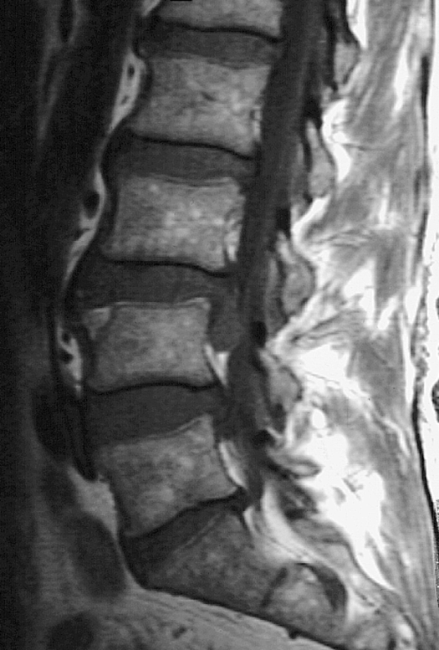
Biomedical model of pain
Pain = damage
More pain = more damage
Pain = nociception = pathology
No pathology = psychogenic
Tissue damage & pain intensity?
Same operation, different outcomes?
Pain without pathology?
Pathology without pain?

Slide 7
Biopsychosocial model
Pain does NOT always equal structural damage
NOT structural but a transmission & reception problem
Software problem
after Loeser 1982, Waddell et al, 1993.

Slide 8
Understanding chronic pain

Slide 9
What do patients want from an analgesic?
At least 50% pain reduction
No worse than mild pain
Relief from related problems
  Improved sleep & mood
No side effects
Those who get better do well
  Improvements in fatigue, mood, and sleep, general measures of function, QoL and ability to work
  O’Brien et al. Pain Med 2010 11: 6-15.

Slide 10
Positive treatment outcomes
Pain reduction (↓ pain score)
Functional changes (↑ activity)
  Overall functional improvement
  Improved exercise tolerance
Behavioural changes
  Improved coping
  Positive social engagement
  Improved self-management skills

Slide 11
Discussion
Rank the following in terms of their analgesic effectiveness.
Acute pain
Chronic pain
Codeine 60mg
Ibuprofen 400 mg
Morphine IM 10 mg
Paracetamol 1g
Paracetamol 1g + codeine 60mg
Tramadol 100mg
Amitriptyline
Duloxetine
Gabapentin
Morphine
Pregabalin

Slide 12
Analgesic league table
Single dose analgesics for moderate to severe acute pain:
Number needed to treat (NNT) for at least 50% maximum pain relief over four to six hours
https://www.rcoa.ac.uk/faculty-of-pain-medicine/opioids-aware/oxford-league-table

Slide 13
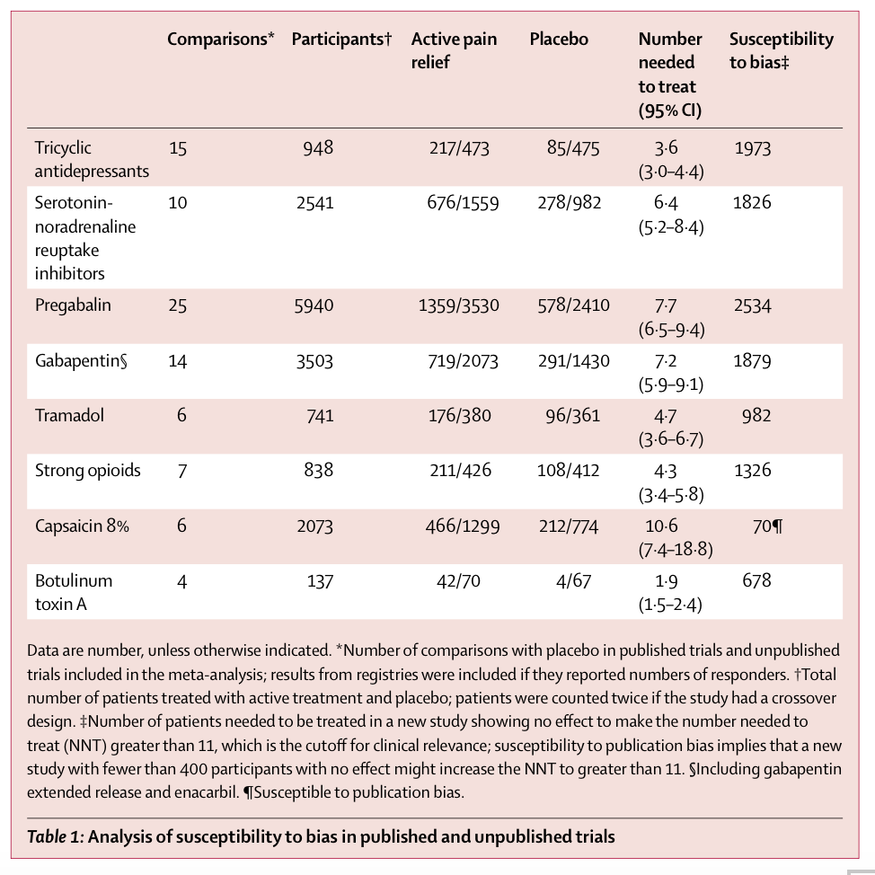
Analgesic efficacy in neuropathic pain
Finnerup N. Lancet Neurol 2015; 14:162.

Slide 14
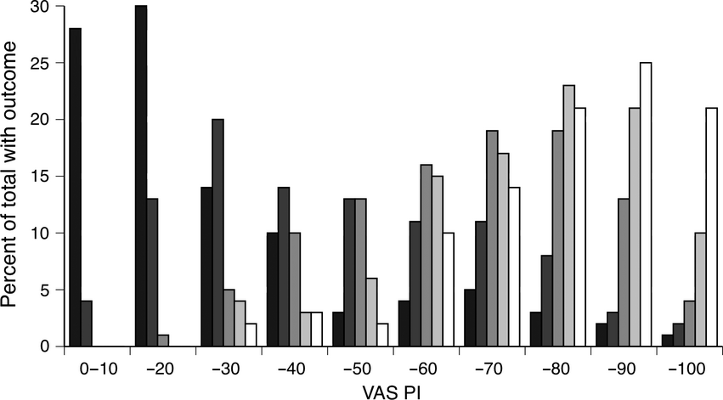
Response to analgesics is not average
Moore RA et al. Anaesthesia 2013; 68: 400-412.

Slide 15

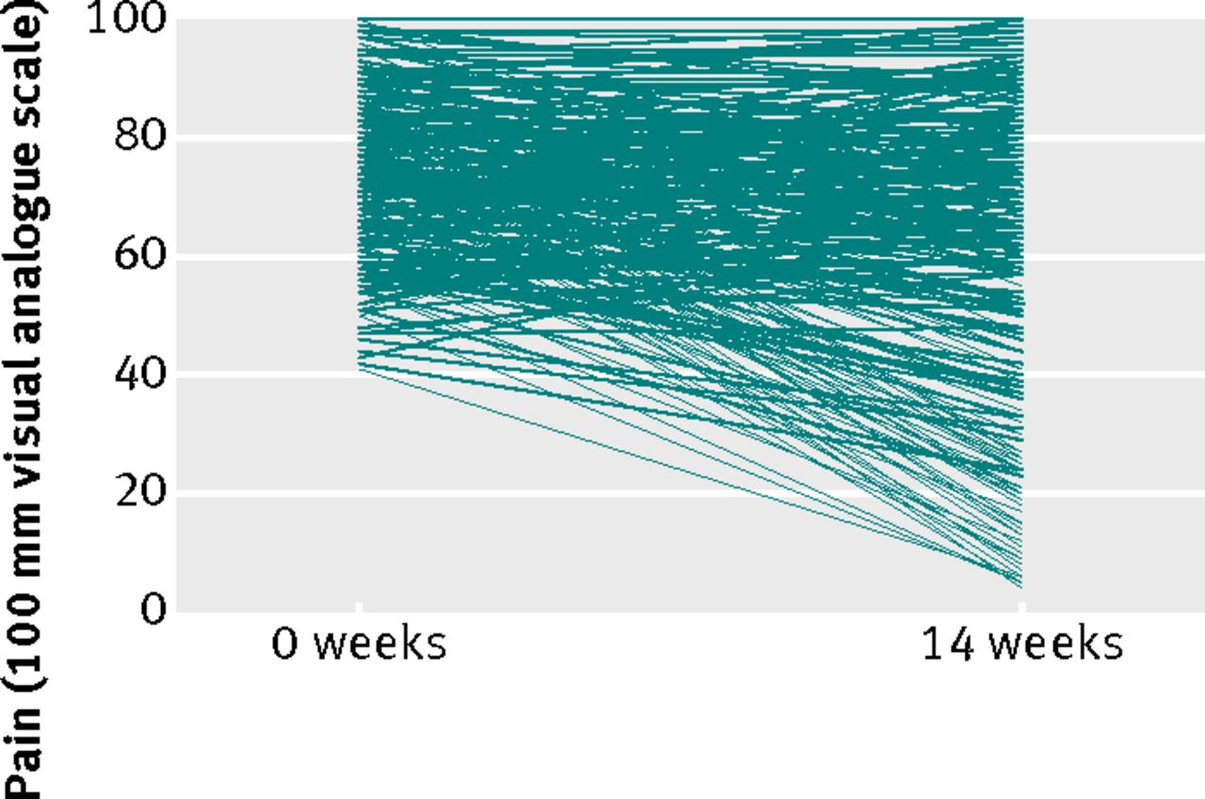
Individual changes in pain after pregabalin in fibromyalgia
Moore A et al. BMJ 2013; 346: bmj.f2690
Notes:
Fig 1 Individual changes in pain over 14 weeks of treatment with pregabalin 450 mg in 200 patients with fibromyalgia

Slide 16
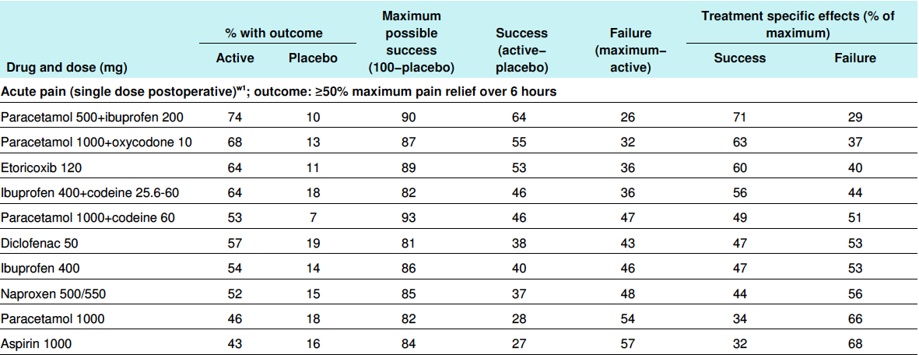
Treatment responses – acute pain
Moore A et al. BMJ 2013;346:bmj.f2690.

Slide 17
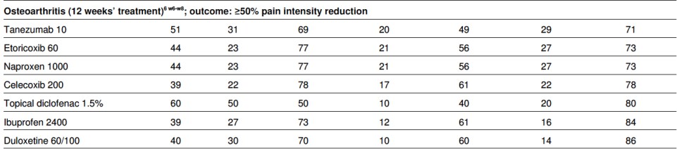
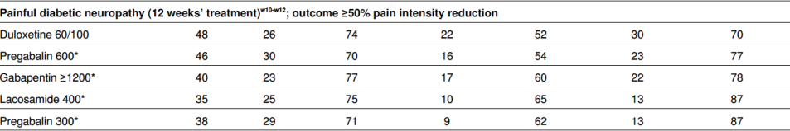
Treatment responses – persistent pain
Moore A et al. BMJ 2013;346:bmj.f2690.

Slide 18
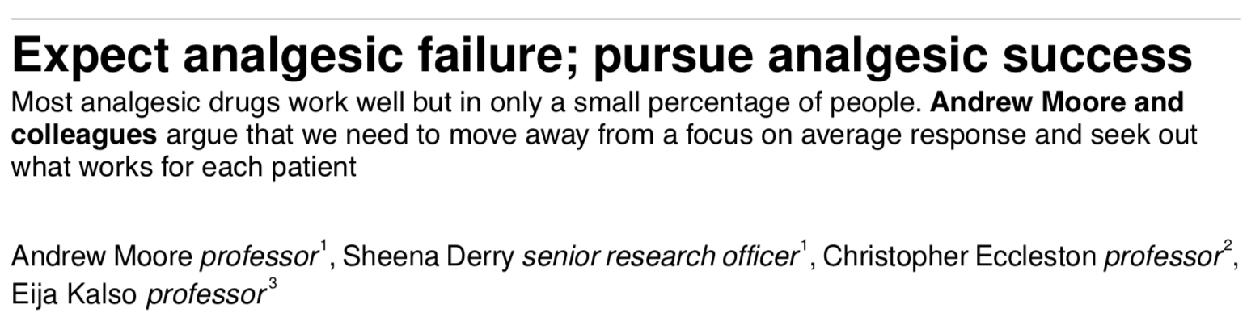
No single drug will treat successfully more than a minority of patients with a painful condition
Experience (and some evidence) suggests that failure with one drug does not necessarily mean failure with others, even within a class
We do not know the best order in which to use drugs, in terms of efficacy, harm, or cost
Success or failure can be determined within 2-4 weeks, and success, when achieved, tends to be long lasting
Because success rates are low, a wide range of drugs is needed to do the best for most patients, especially in complex chronic conditions
Moore A et al. BMJ 2013;346:bmj.f2690.

Slide 19
Improvements in QoL
Patients who get effective pain relief have major improvements in most aspects of quality of life
Dahlöf et al. Health Qual Life Outcom 2007; 5: 56
Moore et al. Pain 2010; 149: 360

Slide 20
Opioid prescribing in the UK
In 2018, 23.4 million prescriptions were dispensed in England costing £239.5 million
Items
Cost
BNF classification 4.7.2 (opioid analgesics)
Compiled from Prescription Cost Analysis. NHS Digital (formerly Health and Social Care Information Centre.

Slide 21
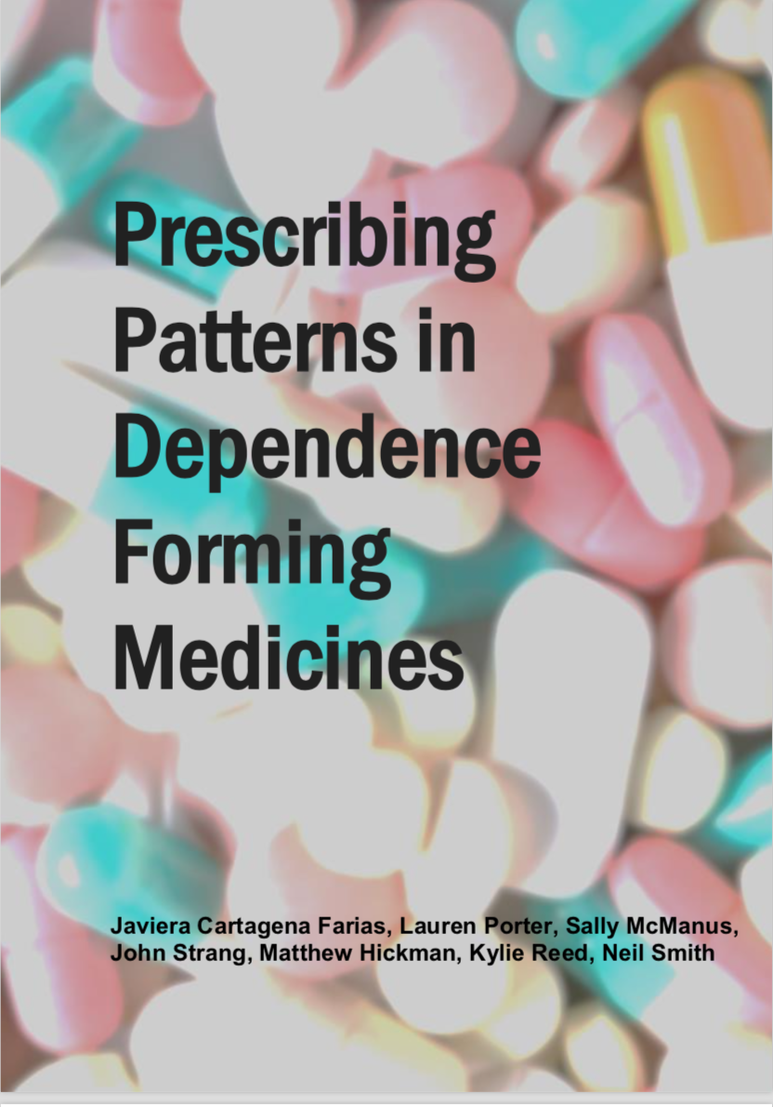
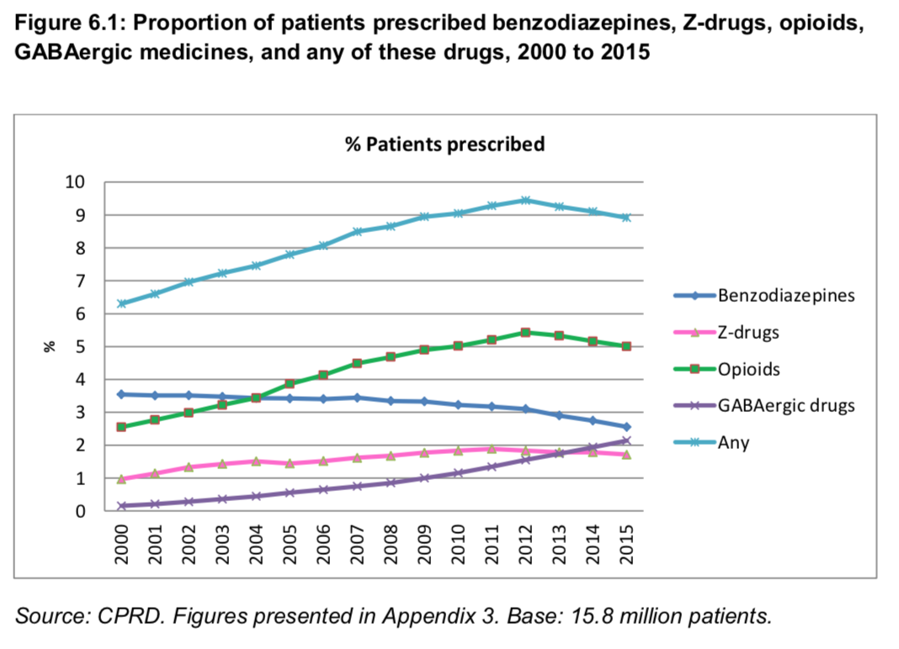
How many patients are prescribed opioids?
Cartagena Farias J et al. Prescribing patterns in dependence forming medicines. 2017. London: NatCen.

Slide 22
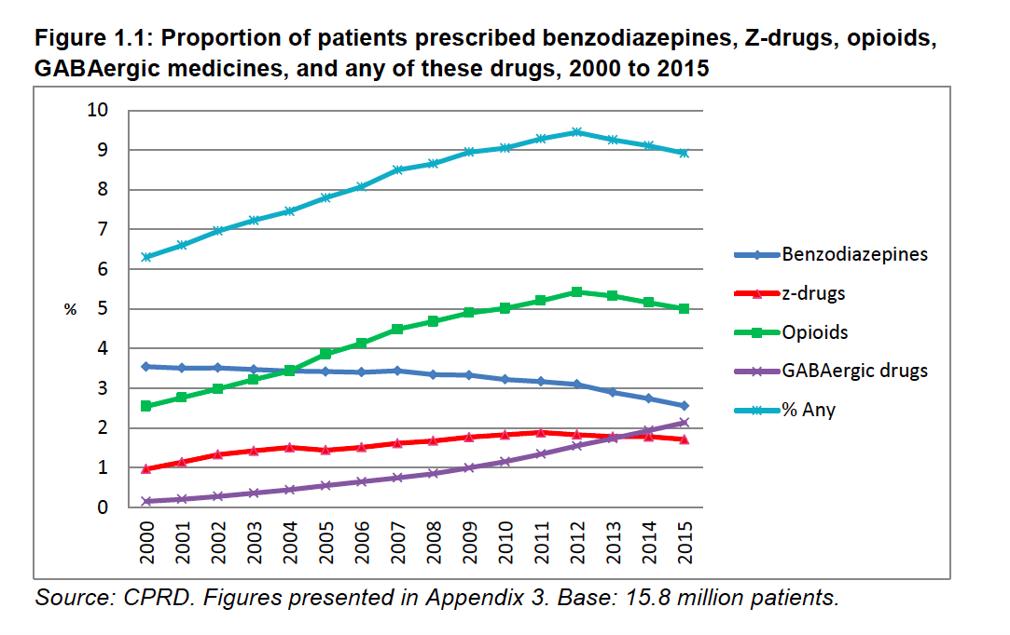
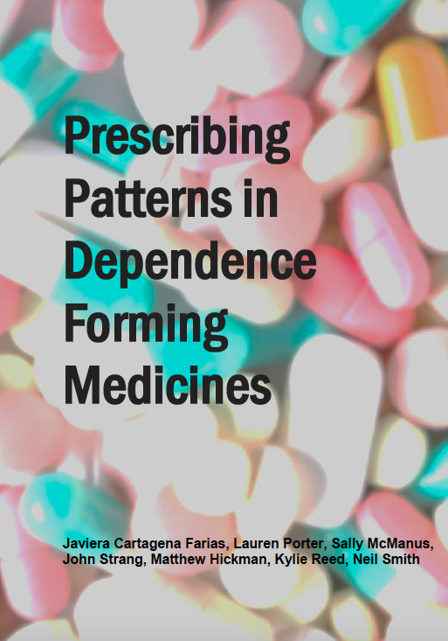
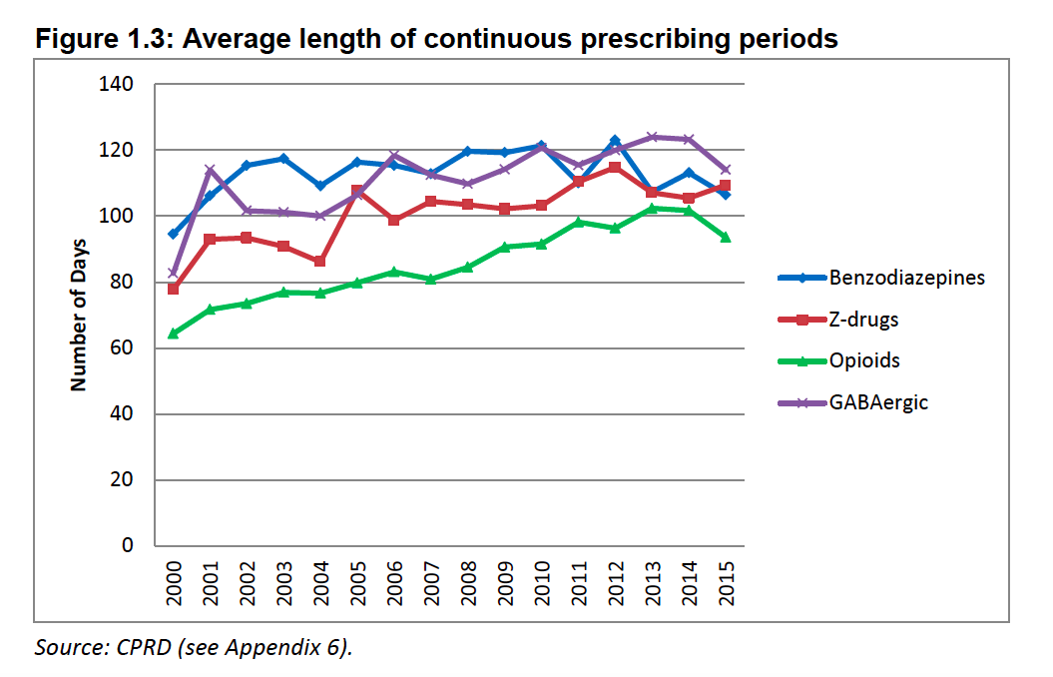
Duration of opioid prescribing
CPRD between 2000 and 2014
Opioids
  Length of continuous prescribing increased
    2000: 64 days
    2014: 102 days
Dependence forming medicines prescribed for longer in areas of deprivation
Cartagena Farias J et al. Prescribing patterns in dependence forming medicines. 2017. London: NatCen.

Slide 23
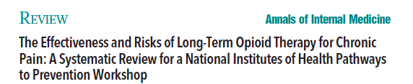
  Efficacy or effectiveness
    No study of opioid therapy versus placebo, no opioid therapy, or non-opioid therapy evaluated long-term (>1 year) outcomes related to pain, function, or quality of life
No evidence relating to:
  different dosing strategies
  short versus long acting
  continuous versus as needed
  opioid rotation
Chou R et al. Ann Intern Med 2015; 162: 276.

Slide 24
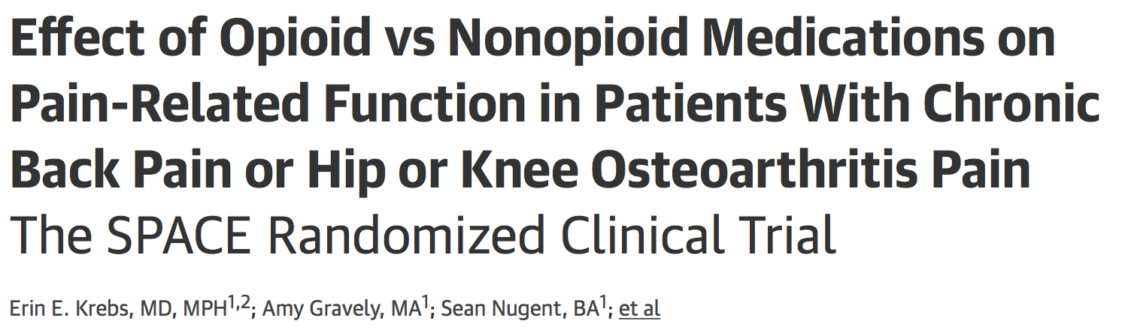
12-month pragmatic randomised clinical trial (n = 240 patients)
Compared the use of opioid vs nonopioid treatment for LBP and OA
No improvement in pain-related function over 12 months (3.4 vs 3.3 points on an 11-point scale at 12 months, respectively)
Pain intensity was significantly better in the nonopioid group over 12 months (mean 12-month BPI severity was 4.0 for the opioid group and 3.5 for the nonopioid group (difference, 0.5 [95% CI, 0.0 to 1.0])
medication-related adverse symptoms were significantly more common in the opioid group over 12 months (overall P = 0.03)
Krebs EE, Gravely A, Nugent S, et al. JAMA. 2018; 319: 872.

Slide 25
Dose dependent risk for serious harms
Increased risk of:
  Sexual dysfunction [OR 1.45 (CI -1.87)]
  Fractures [OR 1.27 (CI 1.21-1.33)]
  Myocardial infarction [OR 1.28 (CI 1.19-1.37)]
  Abuse [wide range – up to 37%]
  Overdose [HR 5.2 (CI 2.1-12.5)]
  Motor vehicle accident [OR 1.24-1.42]
Chou R et al. Ann Intern Med 2015; 162: 276.

Slide 26
Psychiatric co-morbidities
Patients with mood disorders more likely to be started on opioid treatment than those without
Patients with depression almost twice as likely to continue taking those opioids long term
Opioids being used to treat insomnia and stress – symptoms accompanying chronic pain – rather than the pain itself
Dysregulation of the endogenous opioid system in borderline personality disorder, depression, stress
Halbert B, Davis R, Wee CC. Pain 2016; 157: 2452. Sullivan MD. Pain 2016; 157: 2395. Prossin AR, Love TM, Koeppe RA et al. Am J Psychiatry 2010; 167: 925.

Slide 27
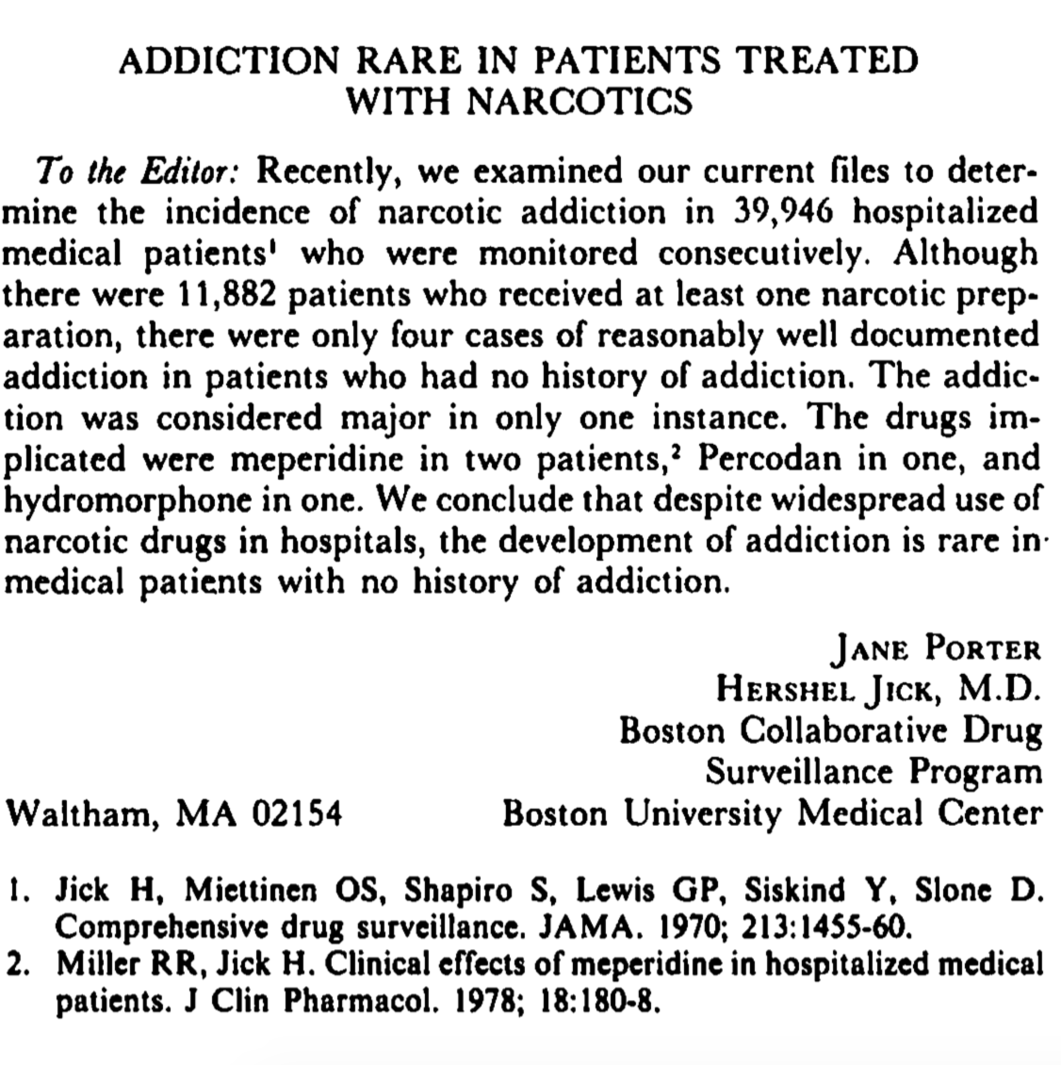
Common misconception:
Addiction thought to be rare
Porter J, Jick H. New Engl J Med 1980; 302:123.

Slide 28
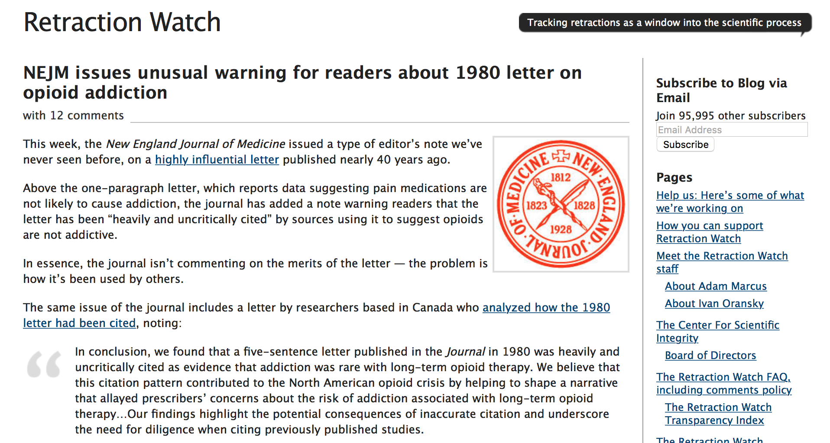
Retraction July 2017
http://retractionwatch.com/2017/06/02/nejm-issues-unusual-warning-readers-1980-letter-opioid-addiction/

Slide 29
Risks of running into problems with opioids
Patient factors
  Depression/common mental health diagnoses
  Alcohol misuse/non-opioid drug misuse
  Opioid misuse
Drug factors
  High doses
  Multiple opioids
  More potent drugs
  Concurrent benzodiazepines/sedative drugs
Wilsey et al. Pain Med 2008; 9: 1107. Gudin et al. Postgrad Med 2013; 125:115. Fishbain et al. Pain Med 2008; 9: 444. Chou et al. Ann Int Med 2015; 162: 276.

Slide 30
Who gets long-term opioid therapy?
Patient factors
  Depression/common mental health diagnoses (x3-4)
  Alcohol misuse/non-opioid drug misuse (x4-5)
  Opioid misuse (x5-10)
At risk patients are more likely to receive
  High doses
  Multiple opioids
  More potent drugs
  Concurrent benzodiazepines/sedative drugs
Edlund et al. Clin J Pain 2010; 26: 1. Morasco Pain 2010; 151: 625. Sullivan Pain 2010; 151: 567-568.

Slide 31
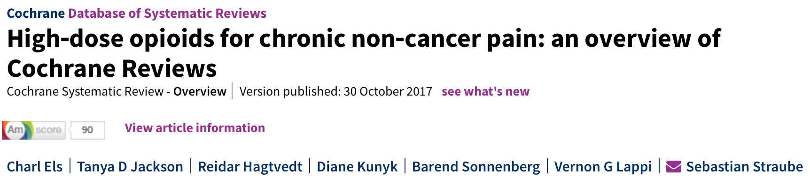
Authors' conclusions
  There is a critical lack of high‐quality evidence regarding how well high‐dose opioids work for the management of chronic non‐cancer pain in adults, and regarding the presence and severity of adverse events. No evidence‐based argument can be made on the use of high‐dose opioids, i.e. 200 mg morphine equivalent or more daily, in clinical practice. Trials typically used doses below our cut‐off; we need to know the efficacy and harm of higher doses, which are often used in clinical practice.
Els C et al.. Cochrane Database of Systematic Reviews 2017, Issue 10. Art. No.: CD012299.

Slide 32
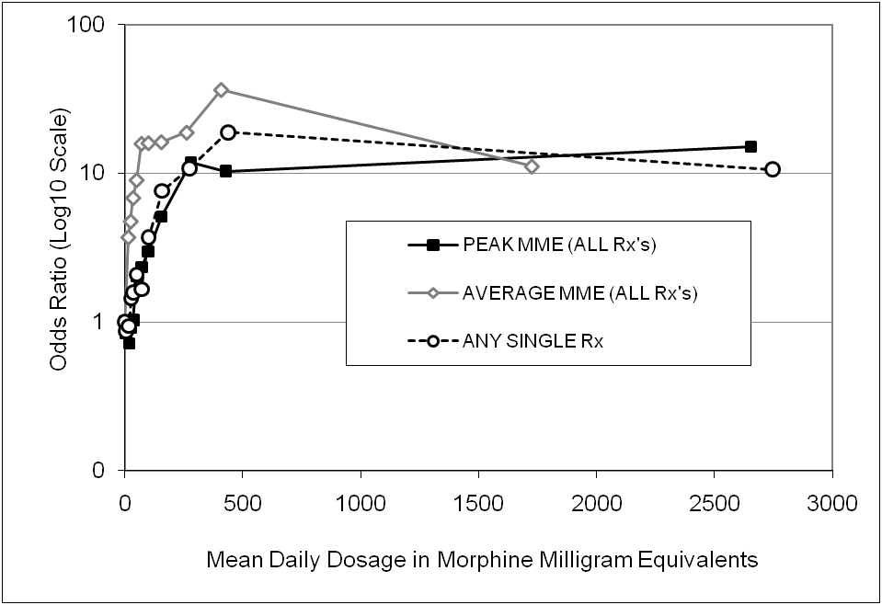
High opioid doses and deaths: a case for a dose limit
**
**
ns
Paulozzi et al. Pain Med 2012.
Dunn et al. Ann Int Med 2010.
**
**
**
**
ns
**
**
Gomes et al. Arch Int Med 2011.
Bohnert et al. JAMA 2011.
Notes:
Consistent increase in mortality (overdose related deaths) – increase in harms, particularly with OMEQ > 100mg/day

Slide 33
Deaths related to drug poisoning in England
Office of National Statistics Deaths Related to Drug Poisoning in England and Wales, 2009 – 2018.

Slide 34
Opioid prescribing
DO NOT Prescribe
  Headache
  Migraine
  Low back pain
  Fibromyalgia
  Abdominal pain
  Pelvic pain
  Widespread pain
Conditions where a trial may be justified:
  Neuropathic pain
  Osteoarthritis

Slide 35
Opioid equivalences
Not all opioids are the same strength!!
Vary depending on source
Problems with equivalence tables or ratios
  Small studies
  Often in volunteers
  Unidirectional
Need to reduce by 25-50% due to cross sensitivity

Slide 36
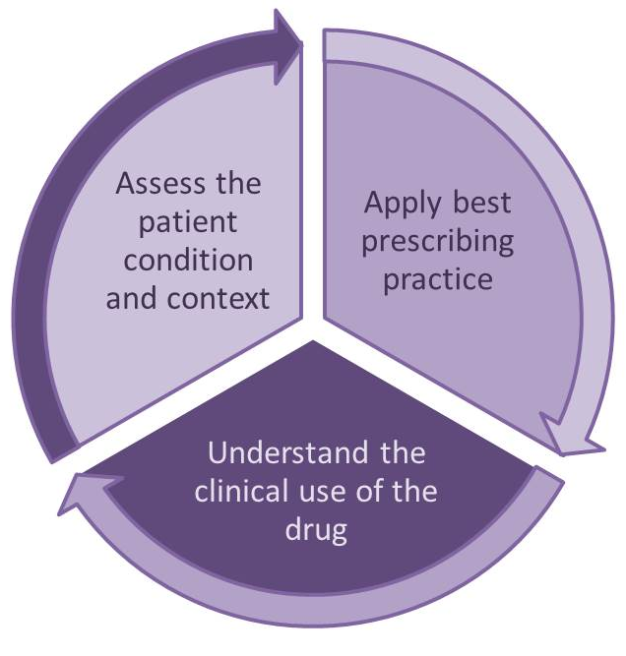

OPIOIDS AWARE
Apply best professional practice
Assess the condition, the patient and their context
Understand the clinical use of the drug
A structured approach to opioid prescribing
Information for patients
https://www.fpm.ac.uk/faculty-of-pain-medicine/opioids-aware

Slide 37
Opioid Prescribing Resource:
OPIOIDS AWARE
What is it?
What it is NOT?
Evidence-based resource reviewing the harms and benefits of opioids
Prescribers can use to make an informed clinical decision for an individual patient, influenced of course by the individual's clinical presentation, comorbidities and circumstances
On-line prescribing resource hosted by FPM
Extensive links to other sources
Guidance
A manual about how to prescribe opioids safely
Re-statement of information from other sources
Notes:
Opioids aware launched November 2015 funded by PHE hosted by FPM

Slide 38
Stopping opioids

Slide 39
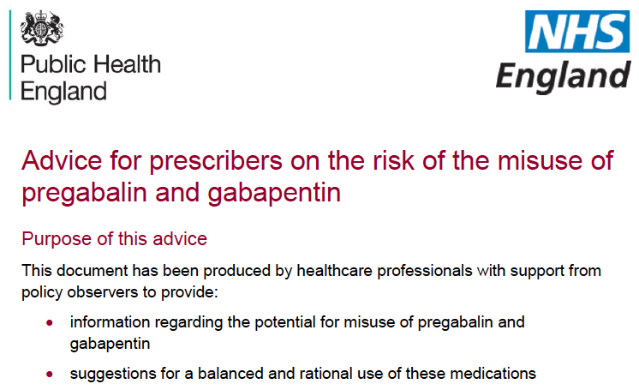
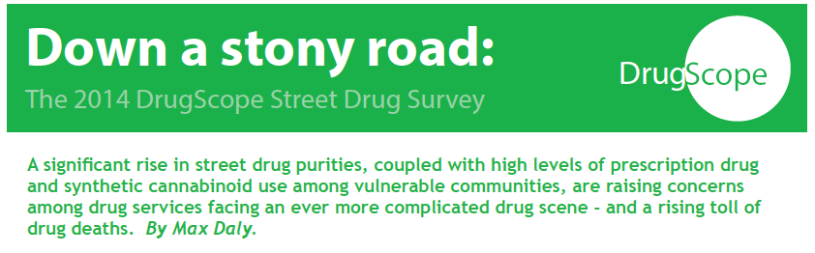
Pregabalin and gabapentin misuse
Only a small proportion benefit sufficiently to notice an improvement in QoL
Prescribing for patients with a known or suspected history of dependence, misuse, diversion may place these people at greater risks
No patient should normally be excluded from access to medicines that may help them simply because of a current or past problem with misuse or dependence, increased monitoring may be required if prescription is appropriate
Misuse has been reported for some years in clients attending substance misuse treatment and recovery services, and within secure environment settings

Slide 40
Increasing safety concerns
12.1 % of all urine specimens from patients with opioid addiction found to be positive for pregabalin. None of the patients concerned had a medical indication for using pregabalin
More likely to be prescribed gabapentin or pregabalin if
  previous substance use disorder treatment or diagnosis (aOR 1.41, 95 % CI 1.31–1.52)
  previously been dispensed high doses of drugs with abuse potential (aOR 1.77, 95 % CI 1.62–1.94)
Grosshans M et al. Eur J Clin Pharmacol 2013; Boden R et Eur J Clin Pharmacol 2014.

Slide 41
Gabapentin, opioids, BDZs and mortality
Gabapentinoids are reversible inhibitors of GABA transaminaseand havean inhibitory effects on the respiratory centre in the medulla
Gabapentinoids reverse tolerance to opioid effects and potentiate respiratory depression
Prescription opioid use associated with risk of opioid-related death:
1 in 550 chronic opioid users dying within 2.5 years of first opioid prescription
Co-prescription of benzodiazepines with opioids increased the risk of overdose death 4 fold
Concomitant gabapentin use (> 900mg per day) was associated with a 60% increase in the risk of opioid-related death
Very high doses gabapentin associated with 2 fold increase
Kaplovitch E et al. PLoS ONE 2015; 10: e0134550. Gomes T et al. PLoS Med 2017; 14: e1002396.

Slide 42
Gabapentinoid related deaths in UK
Office for National Statistics. Deaths related to drug poisoning.

Slide 43
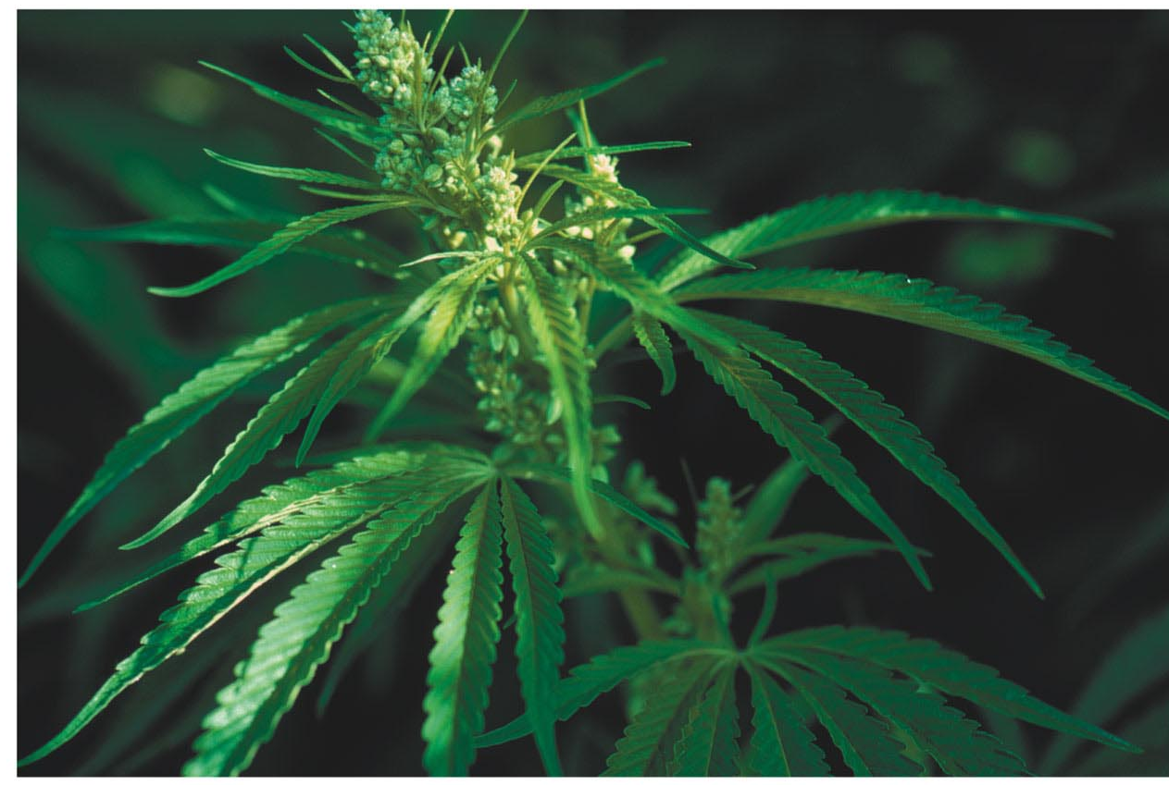
Cannabis sativa
Contains over 700 chemicals
At least 100 cannabinoids have been isolated
As cannabis is a natural product the composition depends on variety and growing conditions
Cannabis has become much more potent
  genetic (selected seed varieties and cultivation of female plants)
  variation in cannabinoids and concentration of THC, CBD, etc
  environmental (hydroponic cultivation techniques, prevention of fertilisation and seed production)
  freshness (the risk of storage degradation of THC is less likely today)

Slide 44
Cannabis: major components
THC
CBD
principal psychoactive constituent of cannabis
partial agonist activity at the CB1 receptor
Associated with euphoria and psychosis
very low affinity for the CB1 and CB2 receptor
May be indirect antagonist at CB1 and CB2 receptors
May reverse some of central effects of THC

Slide 45
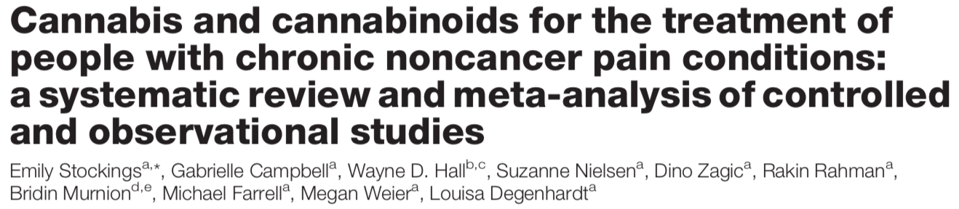

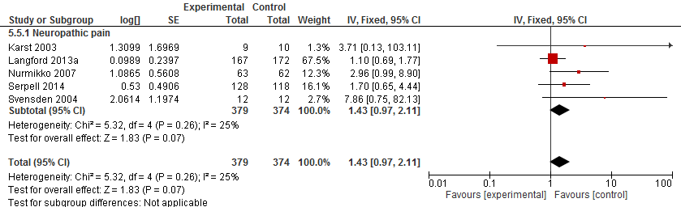
91 publications containing 104 studies were eligible (n = 9958 participants), including 47 randomised controlled trials (RCTs) and 57 observational studies
48 studies examined neuropathic pain, 7 studies examined fibromyalgia, 1 rheumatoid arthritis, and 48 other CNCP (13 multiple sclerosis–related pain, 6 visceral pain, and 29 samples with mixed or undefined CNCP).
Across RCTs, pooled event rates for 30% reduction in pain were 29.0% (cannabinoids) vs 25.9% (placebo); NNTB 24 (95% CI 15-61)
For 50% reduction in pain, PERs were 18.2% vs 14.4%; no significant difference was observed
There were no significant impacts on physical or emotional functioning, and low-quality evidence of improved sleep and patient global impression of change.
Evidence for effectiveness of cannabinoids in CNCP is limited.
Stockings E et al. PAIN. 2018; 159(10): 1932-54.

Slide 46
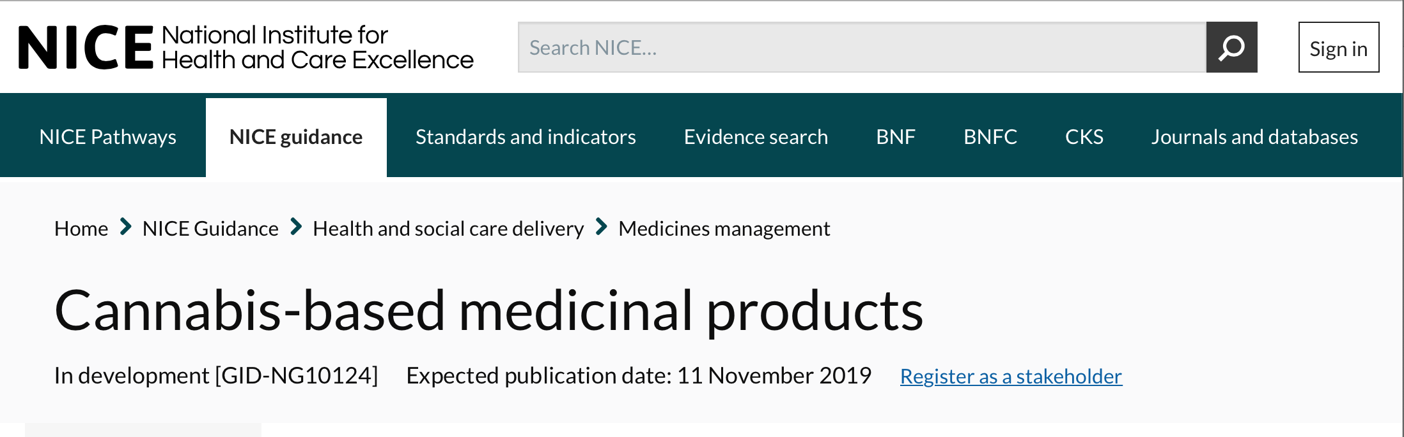
Chronic pain
Do not offer the following to manage chronic pain in adults:
  Nabilone
  dronabinol
  THC (delta-9-tetrahydrocannabinol)
  a combination of cannabidiol (CBD) with THC.
Do not offer CBD to manage chronic pain in adults unless as part of a clinical trial.

Slide 47
Summary
Most analgesics will be ineffective for most people
Unable to predict who will respond to which analgesic
When patients obtain good relief, other domains tend to improve too
Approach should use short sequential trials (4-6 weeks) and taper in no benefit
Consider SOCIOPSYOBIOLOGICAL approach

Slide 48
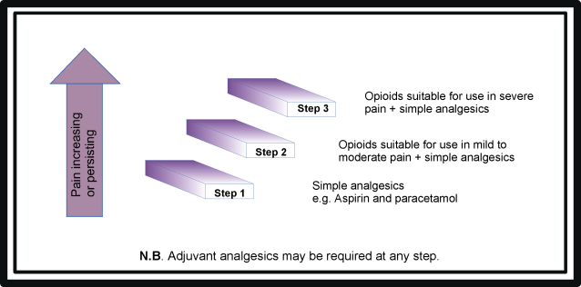
WHO analgesic ladder
O’Neill B, Fallon M. Principles of palliative care and pain control. Br. Med. J. 1997; 315: 801- 804.

